Slide 1


BUSINESS ANALYTICS CLUB
Workshop Series 9.26
Machine Learning
Janet Ye
Shantanu Joshi

Slide 2
Set Ups
Download the zip file from bit.ly/bacdata “Python ML” folder. In the zip file, you’ll find:
Installation Guide
Python Installers
Sublime Text (Text editor) Installers
Windows Users:
Special Library Package File (IMPT: DO NOT edit the name of this file)

Slide 3
Learning Objective
Understand the fundamentals of a Neural Network and it’s application through Python
Install and use basics of Python 2.7
Setup NumPy
Introduce Sigmoid Curves and Backpropagation

Slide 4
Terminology
Machine Learning: the study and construction of algorithms that can learn from and make predictions on data
Neural Network: statistical learning method inspired by biological neural networks
Backpropagation: how our Neural Network will learn…
Sigmoid Function: can map any number to be between 0,1

Slide 5
NumPy Setup

Slide 6
Numpy on Mac
NumPy is a library in python that adds support for arrays or data frames
Mac Users: Type [Command+Space] and type [Terminal], hit enter to open a new terminal window
In the terminal window type [pip install numpy] and hit enter

Slide 7
Numpy on Windows
Installation is tricky. Follow instructions carefully.
Type [Windows+Q] and type [powershell], double click to open [Windows PowerShell]
In PowerShell, type:
cd .\Downloads\python_mlworkshop\Windows\
hit ENTER, then type:
pip install numpy
and instead of hitting ENTER this time, hit the [TAB] key, this should autocomplete to:
numpy-1.9.3+mkl-cp27-none-win32.whl
now hit ENTER
Note: PowerShell will be referred to as the Terminal in the rest of the presentation.

Slide 8
Testing Numpy
Open a new Terminal window (Windows: PowerShell)
Type: python
Once the Python prompt appears type: import numpy as np and hit ENTER, nothing should happen
Type: np and hit ENTER the path of numpy should appear

Slide 9
Building our File
Open Sublime Text and create a new file called neural.py
Save to your DESKTOP
The bottom right corner of sublime text should say [Python]
Type: print “Hello World” and hit save
Open Terminal, type cd Desktop. You should see:
Mac: Desktop your_username$
Windows: C:\Users\your_username

Slide 10
Running a Python File
Once you are in Desktop directory…
Typing [ls] on mac or [dir] in windows will display [neural.py]
Running a file:
Type: python neural.py
You should see Hello World printed on your screen

Slide 11
Sigmoid Function

Slide 12




Sigmoid Function
Maps any value to a value between 0 or 1
Can convert numbers to probabilities
$\frac{dS}{dx}=x∗(1−x)$
$$S(x)$$
$$x$$
$$S\left(x\right)=\frac{1}{1+e^{−x}}$$

Slide 13

Importing Numpy
In Sublime, edit neural.py delete the previous text and leave only:
Syntax:
Importing NumPy in this way allows us to use all the prebuilt functions in the NumPy package
Setting numpy as np simply allows us to use np instead of typing out numpy

Slide 14
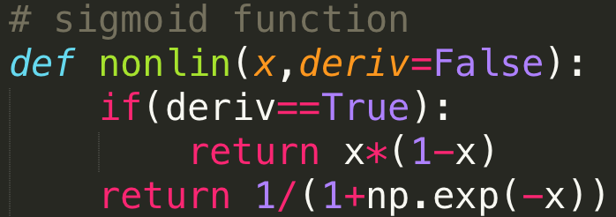
Input the Sigmoid Curve
In Sublime, edit neural.py and type →
Syntax:
def: tells python we are defining a function called nonlin with parameters x and deriv
deriv is an optional variable, and it is set to False by default. You will see in a few slides how to change its value.

Slide 15
Python Indentation
VERY IMPORTANT!
Indents in python are considered syntax.
1 indent = 4 spaces
Nested items require an extra indent than their parent items.
Incorrectly placed or missing indents lead to most python syntax compline errors.
Notes:
Indents in python are considered syntax. Nested items require an extra indent than their parent items. Incorrectly placed indents lead to most python syntax compile errors.

Slide 16
Input the Sigmoid Curve
return tells our function to output something and terminate the function
The next line is an if-statement, if deriv is set to True then the nested statement is returned
If deriv is False, it skips the if statement and the last line is returned

Slide 17
Note: NumPy Usage
Notice the np.exp(-x)
As previously defined we set
numpy as np so this function
actually reads as:
numpy.exp(something)
The numpy.exp function is a function that returns the value of
[e] (~2.718…) raised to the [something] power

Slide 18
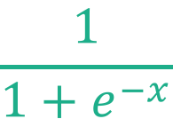

Sigmoid Defined
In the function nonlin we’ve defined the behavior of our sigmoid curve
When [deriv=false] the function tells us
When [deriv=true] the funciton outputs the derivative at a
given [x] which is:
$$\frac{1}{1+e^{−x}}$$
$$1∗(1−x)$$

Slide 19
Initializing the Dataset

Slide 20
Our Data Set
Inputs: | (1) | (2) | (3) | Output
 | 0 | 0 | 1 | 0
 | 1 | 1 | 1 | 1
 | 1 | 0 | 1 | 1
 | 0 | 1 | 1 | 0
We are trying to predict the Output column via the three Input columns
Measuring statistics ex) Leftmost column is perfectly correlated with output will help solve the problem

Slide 21
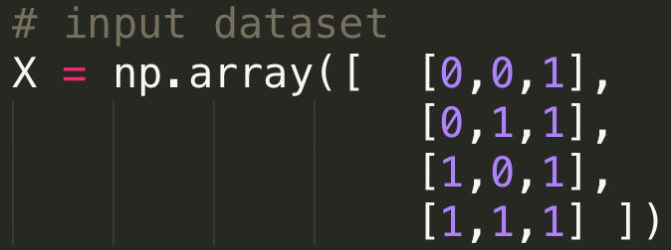
Initializing the Inputs
Type the following after the nonlin definition:
Syntax:
We are setting X to be a matrix representing our inputs
np.array is the NumPy function for multidimensional arrays
Can also be written in one line (no need of special spacing)
X = np.array([ [0,0,1], [0,1,1], [1,0,1], [1,1,1] ])
Notes:
show the tree in weka
Word of caution: biggest pitfall in data mining is overfitting
building a model that fits well to the dataset but fails to generalize
Solution: use 66% of data to build a model, and save 33% to test on

Slide 22
Initializing the Output
Type the following after the input definition:
Syntax:
We are setting y (note: lowercase) to be a vector representing our output
The .T at the end of the array definition is the transpose function in numpy
Why? Because It’s easier to write .T then np.array([[0],[0],[1],[1]])
Notes:
show the tree in weka
Word of caution: biggest pitfall in data mining is overfitting
building a model that fits well to the dataset but fails to generalize
Solution: use 66% of data to build a model, and save 33% to test on

Slide 23


Array Transpose…
$$y^{T}=\left[\begin{matrix}0 \\ 0 \\ 1 \\ 1\end{matrix}\right]$$
$$y=\left[\begin{matrix}0 & 0 & 1 & 1\end{matrix}\right]$$
Notes:
show the tree in weka
Word of caution: biggest pitfall in data mining is overfitting
building a model that fits well to the dataset but fails to generalize
Solution: use 66% of data to build a model, and save 33% to test on

Slide 24

Initializing Random Seed
Type the following after the output definition:
Syntax:
This refers to the seed number for the random function in the np.random module
Random numbers come from normal distributions, the seed allows each random number to come from the SAME normal distribution
That way we train the model using the same random numbers. This allows us to see the true effects of our neural network.
Notes:
show the tree in weka
Word of caution: biggest pitfall in data mining is overfitting
building a model that fits well to the dataset but fails to generalize
Solution: use 66% of data to build a model, and save 33% to test on

Slide 25
Initializing Weights

Slide 26
Initializing Weights
Type the following after the random seed function:
Syntax:
Initial weights will be set to syn0, the first layer synapse
np.random.random((r,c)) returns an r by c matrix (in this case 3x1) of random numbers in the range [0, 1), based off of the seed
2 * np.random.random – 1 manipulates the interval and returns random numbers in the rage [-1, 1)
Notes:
show the tree in weka
Word of caution: biggest pitfall in data mining is overfitting
building a model that fits well to the dataset but fails to generalize
Solution: use 66% of data to build a model, and save 33% to test on

Slide 27
Understand Neural Networks

Slide 28
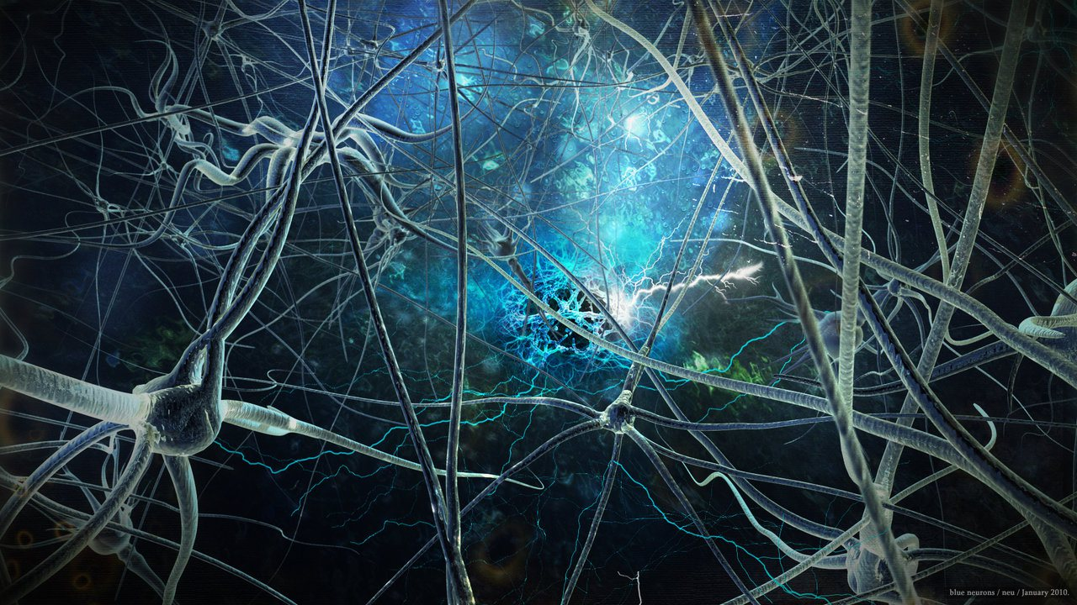
Human Neurons
Notes:
show the tree in weka
Word of caution: biggest pitfall in data mining is overfitting
building a model that fits well to the dataset but fails to generalize
Solution: use 66% of data to build a model, and save 33% to test on

Slide 29
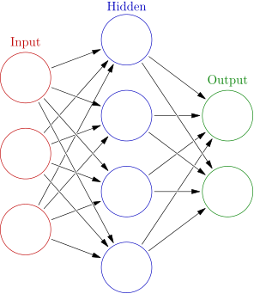
Neural Network
Neural network is a machine learning algorithm that tries to mimic the human brain.
Widely used in the 80s and early 90s, but popularity diminished because it requires intense computational power.
Recent resurgence: state-of-the-art technique for many applications
Notes:
Word of caution: biggest pitfall in data mining is overfitting
building a model that fits well to the dataset but fails to generalize
Solution: use 66% of data to build a model, and save 33% to test on

Slide 30
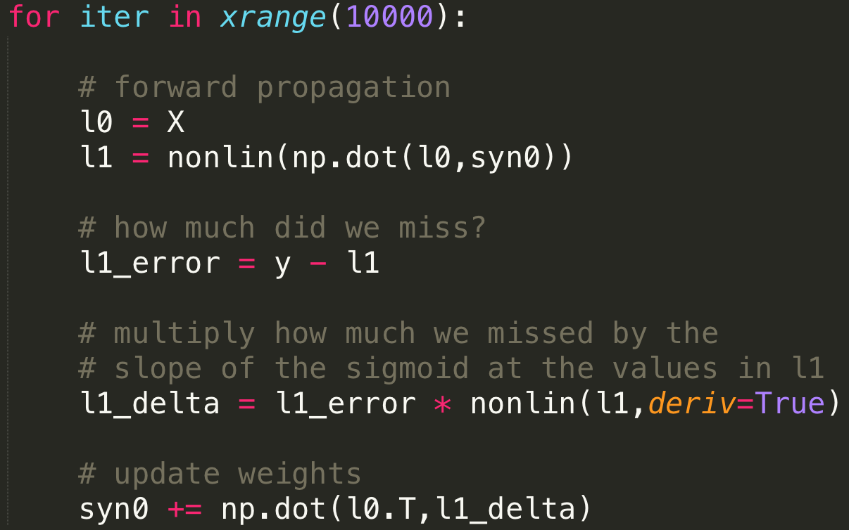
Training Session
Breaking it down line by line…
Notes:
show the tree in weka
Word of caution: biggest pitfall in data mining is overfitting
building a model that fits well to the dataset but fails to generalize
Solution: use 66% of data to build a model, and save 33% to test on

Slide 31
Training Session
We begin a loop by writing:
(Don’t miss the colon at the end!)
xrange (10000) means we are looping iter, our placeholder variable, from 0 to 9999. You can name it anything you’d like, usually people use something like i, or iter
The loop first sets iter to 0, computes everything that is indented under the for loop.
Then set iter to 1, compute…set to 2, compute…etc. The loop stops after iter completes the 10000th round. The value of iter at completion is 9999.
Notes:
show the tree in weka
Word of caution: biggest pitfall in data mining is overfitting
building a model that fits well to the dataset but fails to generalize
Solution: use 66% of data to build a model, and save 33% to test on

Slide 32


Training Session
Forward propagation: going forward with the layers
Sublime text should automatically begin indented block within the for loop
here we set the input layer of the neural network to X
computes the hidden layer.
np.dot(l0, syn0) is the dot product calculation for matrices
Then we pass the dot product to the nonlin function we wrote
How did we do? compares our prediction (what sigmoid function outputs) with the actual y
Notes:
show the tree in weka
Word of caution: biggest pitfall in data mining is overfitting
building a model that fits well to the dataset but fails to generalize
Solution: use 66% of data to build a model, and save 33% to test on

Slide 33
Training Session
Recall in Calc 1, Euler’s method says dy = dx * slope
l1_error is like your dx
nonlin(l1, True) calls the nonlin function. It sees the deriv=True, and enters into the if statement
l1_delta is like your dy
Notes:
show the tree in weka
Word of caution: biggest pitfall in data mining is overfitting
building a model that fits well to the dataset but fails to generalize
Solution: use 66% of data to build a model, and save 33% to test on

Slide 34
Training Session
Computer science syntax: i += 1 is the shorthand for i = i + 1 (Similarly, i -= 1 is the same as i = i – 1)
We now adjust syn0, the first layer synapse, by adding an adjustment term – the dot product of l0 and l1_delta
This step is called backward propogation
The loop continues…iter is incremented by 1
Notes:
show the tree in weka
Word of caution: biggest pitfall in data mining is overfitting
building a model that fits well to the dataset but fails to generalize
Solution: use 66% of data to build a model, and save 33% to test on

Slide 35
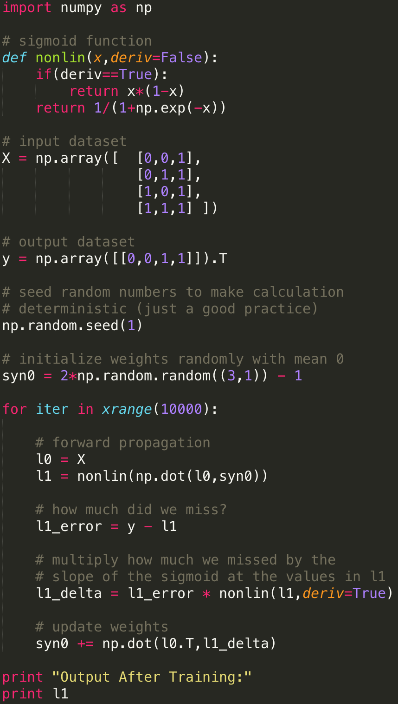
So far, you should have something like this.
Take a second to modify your code if need be.
Pay attention to indentation, commas, and colons
Notes:
show the tree in weka
Word of caution: biggest pitfall in data mining is overfitting
building a model that fits well to the dataset but fails to generalize
Solution: use 66% of data to build a model, and save 33% to test on

Slide 36
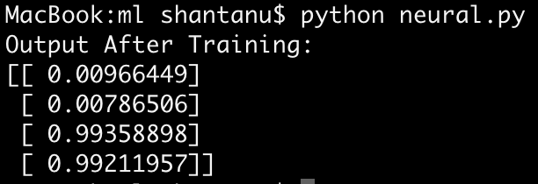
Running Code
In Terminal, (Desktop should be your current directory), type
python neural.py
You should get something like…results are quite good
Notes:
show the tree in weka
Word of caution: biggest pitfall in data mining is overfitting
building a model that fits well to the dataset but fails to generalize
Solution: use 66% of data to build a model, and save 33% to test on

Slide 37
Real Life Example: Self-Driving Car
Notes:
show the tree in weka
Word of caution: biggest pitfall in data mining is overfitting
building a model that fits well to the dataset but fails to generalize
Solution: use 66% of data to build a model, and save 33% to test on

Slide 38
Useful Resources
Free Stanford Machine Learning on Coursera
Link: https://www.coursera.org/learn/machine-learning
Blog with detailed write-ups http://www.holehouse.org/mlclass/index.html
Reddit: https://www.reddit.com/r/MachineLearning/wiki/index
Machine Learning Data Sets: http://archive.ics.uci.edu/ml/
Machine Learning Visualization: http://www.r2d3.us/visual-intro-to-machine-learning-part-1/
Dope Blog: http://www.wzchen.com

Slide 39
Acknowledgement
Andrew Trask
Product Manager @
Digital Reasoning

Slide 40
Appendix – Command Line Navigation
Navigation Tips:
Type [cd] to change directories
[cd ..] to move up a directory
Type [ls] on mac or [dir] in windows to see contents of your current directory
Typing tab will autocomplete with items from your current directory
Typing [pwd] on a mac or [cd] in windows will list the current directory path

